Slide 1
Solutions to Runoff Management

Slide 2
Review
What is runoff?
What factors contribute to runoff?

Slide 3
Runoff Review
Runoff: when rain hits saturated or impervious ground and flows overland downhill to a stream, lake, or watershed.
Influenced by:
Meteorological Factors
Physical Characteristics of the Land
Human Changes to the Landscape

Slide 4
The Problem Associated With Runoff
What is the Problem?
Nutrient pollution is one of America’s most widespread, costly and challenging environmental problems.
Caused by excess nitrogen and phosphorus in the air and water.
Too much nutrients in soil, water, and air leads to environmental and human problems

Slide 5
Nutrient Runoff in Water
Nitrogen and phosphorus are nutrients that are natural parts of aquatic ecosystems
Both support the growth of algae and aquatic plants, which provide food and habitat for fish, shellfish and smaller organisms that live in water
When too much of certain elements enters the ecosystems it can cause pollution in our water sources
Can cause algae to grow faster than an ecosystem can handle.
Large growths of algae are called algal blooms
Algal booms can reduce or eliminate oxygen in the water, leading to illnesses in fish and the death of large numbers of fish.
Example: The Hypoxia in the Gulf of Mexico or Cape Cod

Slide 6
Nitrogen
Most abundant element in the air we breathe
Nitrogen constitutes 78% of Earth's atmosphere and is part of all living tissues.
Vital to plant growth because it is a major component of photosynthesis
Commercial use of nitrogen is as a component to manufacture ammonia, used as fertilizer
Nitrogen molecules occur mainly in air. In water and soils nitrogen can be found as nitrates and nitrites.
In its gas form, nitrogen is colorless, odorless and generally considered as inert.
In its liquid form, nitrogen is also colorless and odorless, and looks similar to water

Slide 7
Phosphorus
Helps plants capture and convert the sun's energy into useful plant compounds.
Is a vital component of DNA
Component of RNA, the compound that reads the DNA genetic code to build proteins and other compounds essential for plant structure, seed yield and genetic transfer.

Slide 8
Phosphorus
Is essential for specific growth factors that include
Stimulated root development
Increased stalk and stem strength
Improved flower formation and seed production
More uniform and earlier crop maturity
Increased nitrogen N-fixing capacity of legumes
Improvements in crop quality
Increased resistances to plant diseases
Supports development throughout entire life cycle

Slide 9
Sources of Runoff
Point source pollution: A collective term for contaminants which originate from a specific point, such as an outfall pipe. Point sources are generally regulated by an NPDES permit
Nonpoint source pollution: A collective term for contaminants which originate from diffuse sources, such as a farm field. Can not specifically determine where pollution is coming from.

Slide 10
Sources of Runoff– Agriculture
Agriculture
Animal manure, excess fertilizer applied to crops and fields, and soil erosion
Fertilizers and animal manure, which are both rich in nitrogen and phosphorus, are the primary sources of nutrient pollution from agricultural sources.

Slide 11
Sources of Runoff - Stormwater
Stormwater
Precipitation that falls in cities and towns. Runs across sidewalks, and roads and picks up pollutants before entering local waterways
Storm flow/storm water: The fraction of discharge (flow) in a river which arrived as surface runoff directly caused by a precipitation event (rain). Storm water generally refers to runoff which is routed through some artificial channel or structure, often in urban areas.

Slide 12
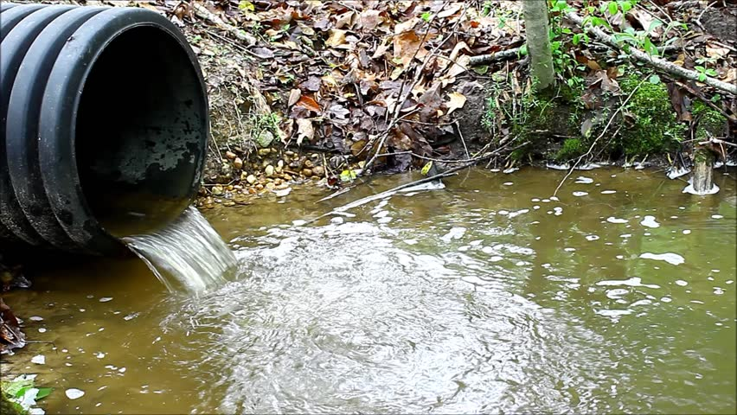
Sources of Runoff– Wastewater
Wastewater
Our sewer and septic systems are responsible for treating large quantities of waste, and these systems do not always remove enough nitrogen and phosphorus before discharging into waterways.

Slide 13
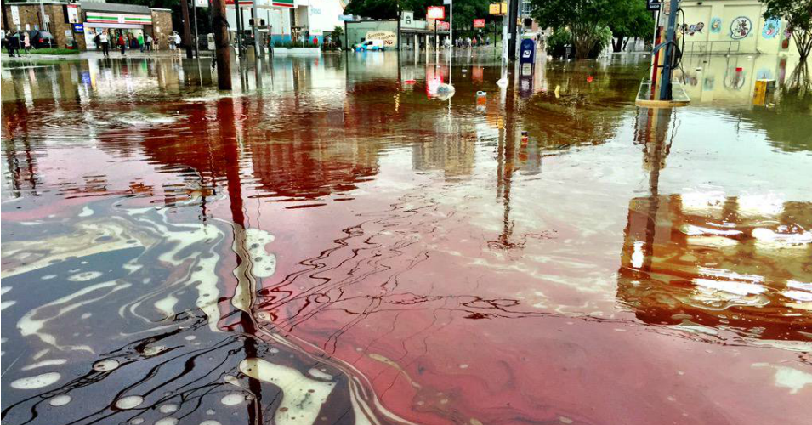
Sources of Runoff– Fossil Fuels
Fossil Fuels
Electric power generation, industry, and transportation using fossil fuels

Slide 14
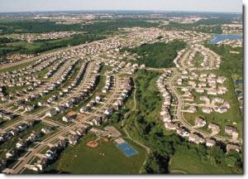
Sources of Runoff– In and Around the Home
In and Around the Home
Fertilizers for yards, yard and pet waste, and certain soaps and detergents containing nitrogen and phosphorus
The amount of hard surfaces and type of landscaping can also increase the runoff of nitrogen and phosphorous during wet weather

Slide 15
Activity
Investigation Creation
1.) Based off of the information you have previously learned from lessons, investigate what you think would be a way to reduce runoff.
2.) You can research current practices and then pick one and make changes to it or you can create your very own idea.
3.) Draw a plan for your idea or write a brief description of your idea. Be prepared to share your idea.
Think about how humans, plants, animals and other organisms still need to use water.
How does surface water differ in different ecosystems?
One goal is to increase crop yield. How could minimizing surface runoff help increase crop yield?
What would the potential cost be of implementing your solution?
What criteria did you use to develop your plan?
What trade-offs will there be?
Consider: safety, reliability, and aesthetics for your solution.
4.) Present your idea/concept to the rest of the class.

Slide 16
Ways to Reduce Runoff
Best Management Practice (BMP)
Watershed efforts
Nutrient Management
Cover Crops
Buffers
Conservation Tillage
Managing Livestock Waste
Drainage Water Management
Edge of Field (water) Monitoring

